Slide 1
POPULAR OPERATING SYSTEMS
PRESENTATION

Slide 2
INDEX
WHAT IS A OPERATING SYSTEM?
WHAT IS A MOBILE OPERATING SYSTEM?
TOP TEN (10) POPULAR OPERATING SYSTEMS
ANDROID OPERATING SYSTEM
WINDOWS OPERATING SYSTEM
APPLE IOS OPERATING SYSTEM
SYMBIAN OPERATING SYSTEM
COMPARISON
OTHER POPULAR OPERATING SYSTEMS
CONCLUSION

Slide 3

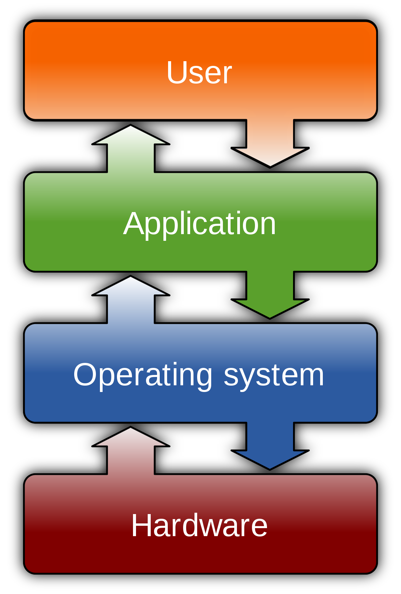
WHAT IS A OPERATING SYSTEM
An operating system (OS) is system software that manages computer hardware and software resources and provides common services for computer programs.

Slide 4
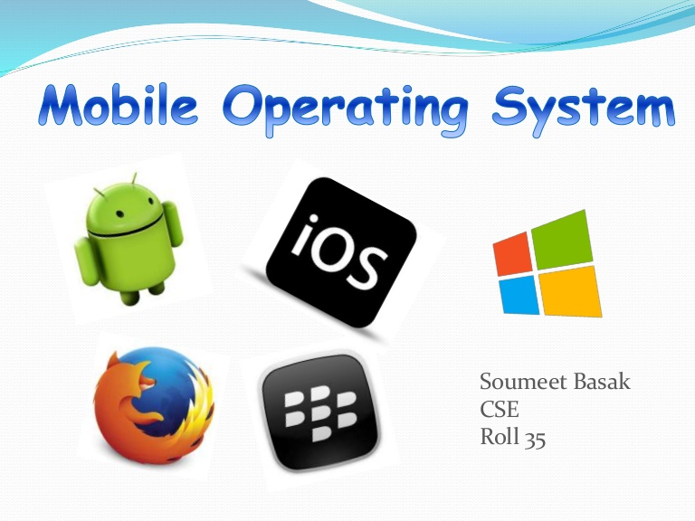
WHAT IS A MOBILE OPERATING SYSTEM
A MOBILE OPERATING SYSTEM is the operating system that controls a smartphone, tablet, PDA or other mobile devices. It is responsible for determining the functions and features available on your device, such as thumb wheel, keyboards ,WAP , text messaging, email ,synchronizing with applications and more.
MAJOR MOBILE OS
ANDROID OS
APPLE IOS
WINDOWS PHONE OS
SYMBIAN OS

Slide 5

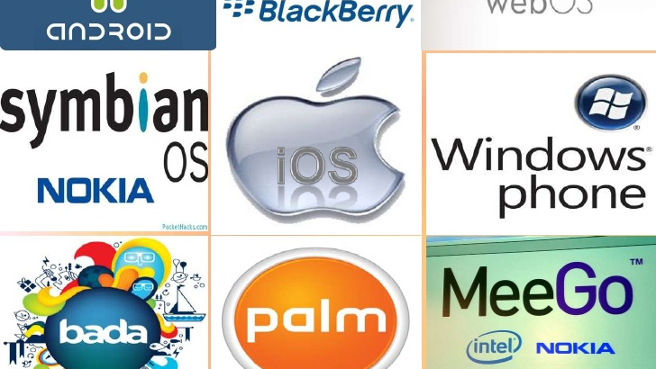
TOP TEN (10) POPULAR OPERATING SYSTEMS
ANDROID OS
WINDOWS PHONE OS
APPLE IOS
SYMBIAN OS
MEEGO OS
BLACKBERRY OS
PALM OS
BADA OS
OPEN WEBOS
MAEMO

Slide 6
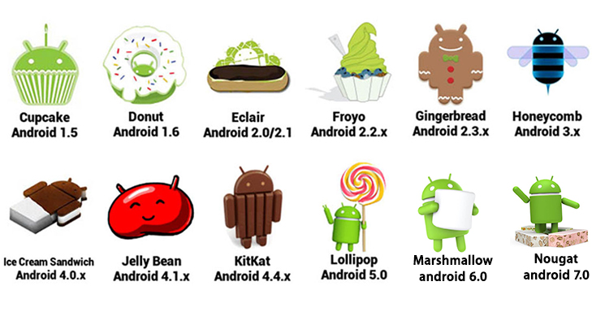
ANDROID OPERATING SYSTEM
Android is from the google Inc. On September 20th 2008 was the date when google released the first Android OS by the name of “ASTRO”
The latest version of Android is the 7.0 NOUGAT
It is a free and open source
Android versions are released according to alphabetical order and developed under a code name.
It is available in 46 languages
The android logo was derived from the Atari game called “Gauntlet: The Third Encounter”
ANDROID VERSIONS

Slide 7
ANDROID FEATURES
INTERFACE
Android’s user interface is based on direct manipulation.
APPLICATIONS
Android has a growing selection of third party applications.
Users can get apps from App stores such as, the Google Play Store or the Amazon Appstore.
Users can also get apps by installing and downloading the applications APK File from the third party site.
MULTI-TOUCH
Multi-touch refers to a touch sensing surface’s ability to recognize the presence of two or more points of contact with the surface.
Multi-touch functionality enables users to perform multiple finger gestures , such as pinching the screen for zooming in, or spreading the screen for zooming out. Multi-touch also enables wiping and rotating.

